Slide 1
Green Book

Slide 2
Agenda
Terms And Definition
Name & Addressing
Application Association
Application Model
Intercontectivity and Interoperability

Slide 3
Terms & Definitions

Slide 4
Terms And Definitions
Physical Device
  The Physical device, is our meter, it supports one or more communication profiles.
Logical Device
  A physical device hosts one or several Logical Devices.
  A logical device models a specific functionality of the physical device.
  For example, in a multi-energy meter, one logical device could be an electricity meter, another, a gas-meter etc.
  Each logical device has an address, called the logical device address.
Application Entity
  The system-independent application activities that are made available as application services to the application agent.
Application Association
  A cooperative relationship between two application entities, formed by their exchange of application protocol control information through their use of presentation services.
Notes:
What is smart meter , how does it works, how beneficial , what energy companies do by collecting meters reading?????

Slide 5
Application Process
  performs the information processing for a particular application.
Application Context
  Set of application service elements, related options and any other information necessary for the interworking of application entities in an application association.
Cosem Data
  COSEM interface object attribute values, method invocation and return parameters.
Cosem Interface Class
  An entity with specific set of attributes and methods modelling a certain function on its own or in relation with other interface classes.
Cosem Interface Object
  An instance of the Cosem Interface Class.
DLMS Message
  An xDLMS APDU.

Slide 6
PULL Operation
  a style of communication where the request for a given transaction is initiated by the client
PUSH Operation
  a style of communication where the request for a given transaction is initiated by the server

Slide 7
Naming And Addressing

Slide 8
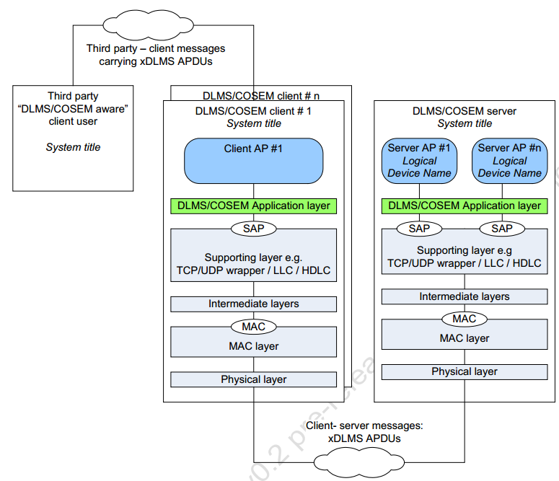

Slide 9
Naming And Addressing
Naming
  DLMS/COSEM entities, including clients, servers as well as third party systems shall be uniquely named by their system title.
  System titles shall be permanently assigned.
Address
  Each physical device shall have an appropriate address.
  It depends on the communication profile and may be a phone number, a MAC address, an IP network address or a combination of these.
  Physical device addresses may be pre-configured or may be assigned during a registration process,which also involves binding between the addresses and the system titles.
  Each COSEM client and COSEM logical device AE is bound to a Service Access Point (SAP).
  The SAPs reside in the supporting layer of the COSEM AL.
Notes:
DLMS:-
1) It is an application layer specification, independent of the lower layers and thus of the communication channel
2) Designed to support messaging to and from (energy) distribution devices in a computer-integrated environment.
3) Its objective to provide an interoperable environment for structured modelling and meter data exchange
COSEM:-
1) Its interface Model providing the view of the functionality of communication interface,
2) COSEM models physical metering equipment as a set of logical devices.
3) Information contained in each logical device is modelled by interface objects.
4) Access to the interface objects within a logical device is modelled by association objects.
5) An association object provides information about the resources available in the logical device in a given context.
6) The information that is held by an interface object is organised in attributes.
7) Attributesrepresent the characteristics of an object by means of attribute values.
8) An object may also offer a number of methods to either examine or modify the values of the attributes.
9) Object that share common characteristics (same attributes and methods) make up an interface class identified by the class_id and version.
10) The attributes and methods of COSEM interface objects can be accessed using xDLMS application layer protocol services, turning the information into series of bytes and transporting these over the protocol layers between peer applications.

Slide 10
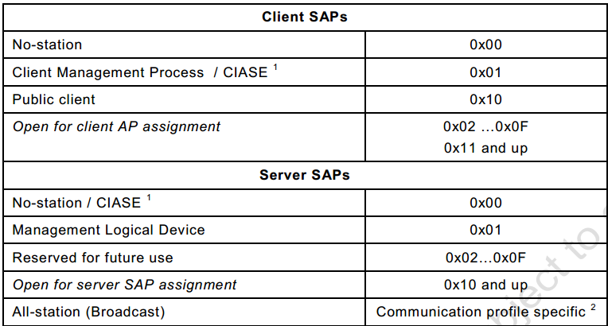
Notes:
1)Modelling: This covers the data model of metering equipment as well as rules for data identification. The data model provides a view of the functionality of the
meter, as it is available at its interface(s). It uses generic building blocks to model this functionality. The model does not cover internal, implementation - specific issues.
2) Messaging: This covers the communication services and protocols for mapping the elements of the data model to application protocol data units (APDU).
3) Transporting: This covers the services and protocols for the transpo rtation of the messages through the communication channel.

Slide 11
System Title
  shall be 8 octets long; shall be unique.
  The leading (i.e., the 3 leftmost) octets should hold the three-letter manufacturer ID1, the remaining 5 octets shall ensure uniqueness.
  The use of system title in cryptographic protection of xDLMS messages and COSEM data .
Logical Device Name
  The LDN is defined as an octet-string of up to 16 octets. The first three octets shall carry the manufacturer identifier 1.
  The manufacturer shall ensure that the LDN, starting with the three
  octets identifying the manufacturer and followed by up to 13 octets, is unique.
Client/Server Operation
Connection Oriented Operation

Slide 12
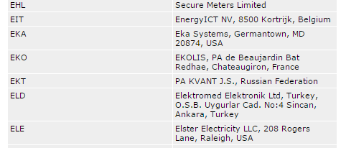

Slide 13
Client User Identification
This new feature enables the server to distinguish between different users from the client side and to log their activities accessing the meter.
Each AA established between a client and a server can be used by several users on the client side.
The properties of the AA are configured in the server, using the “Association” and the “Security set up” objects.
The list of users – identified by their user_id and user_name – is known both by the client and the server.
In the server it is held by the user_list attribute of the “Association” objects.
During AA establishment, the user_id – belonging to the user_name – is carried by the
calling-AE-invocation-id field of the AARQ APDU.
If the user_id provided is on the user_list, the AA can be established – provided that all other conditions are met – and the current_user attribute is updated.
The value of this attribute can be logged

Slide 14
Application Association

Slide 15
Application Associations
Application Associations (AAs) are logical connections between a client and a server AE.
Each AA determines the contexts in which information exchange takes place.
A COSEM logical device may support one or more AAs, each with a different client.
AAs may be confirmed or unconfirmed, they may be established on the request of a client ,or may be pre-established .
A confirmed AA is proposed by the client and accepted by the server provided.
  The elements of the proposed xDLMS context can be successfully negotiated.

Slide 16
An unconfirmed AA is also proposed by a client with the assumption that the server will accept it.
  No negotiation takes place.
  Unconfirmed AAs are useful for sending broadcast messages from the client to servers.
An AA can be established only if the client and the server successfully authenticate themselves.
DLMS/COSEM information exchange can take place only within established AAs.
AAs are modelled by COSEM “Association SN/ LN” objects that hold the SAPs identifying the associated partners, the name of the application context, the name of the authentication mechanism
and the xDLMS context.
Notes:
1) This unique combination of features, not available in any other metering protocols known presently.
2) As the interface model is completely independent from the communication media, a wide choice of media can be used, without ever changing the model and the data management application of the data collecting system.
3) Unlike with older protocols, where - for example in the case of using IEC 61107 - a specific device driver in the data collection system was necessary for every new metering equipment, DLMS/COSEM facilitates to build generic drivers, able to communicate various meter types from different manufacturers.

Slide 17
The Sub-parts of the Application Association
  Application Context
  Authentication
  xDLMS context
  Security context
  Access Rights
  Messaging Patterns .
Communication Profile
Data Exchange between Third Parties and DLMS/COSEM servers.

Slide 18
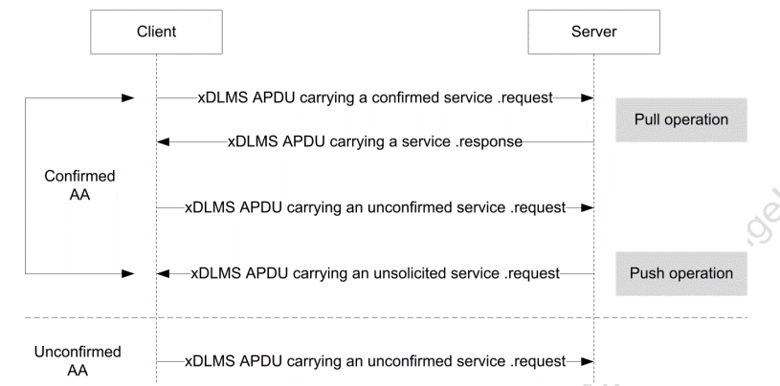
Notes:
On the interface model level, the essential elements assuring interoperability are:
1)the standardised interface classes and data types;
2)the object identification system, providing a standard identifier for each and every object;
3)the possibility to retrieve the resources available in the metering equipment by reading the COSEM association objects.
4) interoperability is ensured by the possibility to negotiate the protocol context, the authentication mechanism and the service set available for accessing attributes and methods.

Slide 19
Application Models

Slide 20
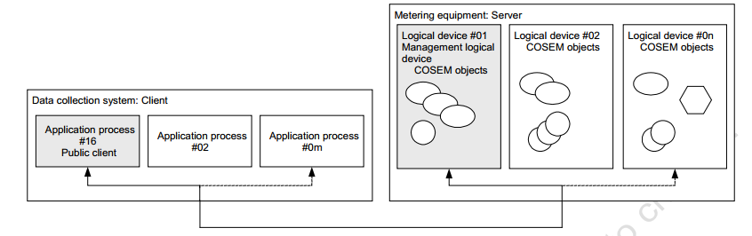
Application Models

Slide 21
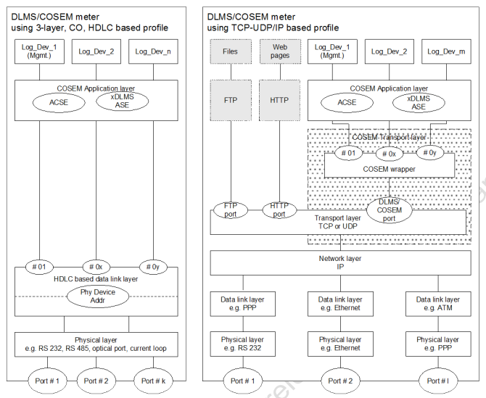
Model of a DLMS/COSEM based Server
Notes:
1)One of the strengths of DLMS/COSEM is that application modelling is well separated from the communication profiles. Therefore, application data can be easily transported over various media.
2)The application is modelled by mapping application-relevant information to attributes and methods of appropriate COSEM objects like Registers, Clocks, Scripts, Profiles etc.
3)Data exchange takes place then by reading or writing the attributes and activating the methods necessary, using xDLMS services provided by the COSEM Application layer.
4)For any communication profile, the connection and data transfer services of the application layer are mapped to the services of supporting lower layers.
5)Currently, this mapping is defined for two communication profiles: the 3-layer, connection-oriented HDLC based profile and the TCP-UDP/IP based profile and new profiles can be added when needed.

Slide 22
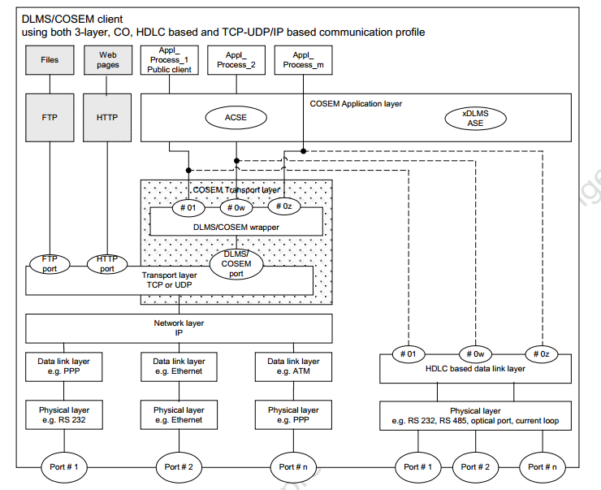
Model of a DLMS/COSEM based Client

Slide 23
Interoperability & Inter-connectivity in COSEM
Interoperability and Interconnectivity is defined between client and server Aes.
Interoperability : a client AE is interoperable with a server AE, if it is able to establish AAs using the A-Associate service of the standard connection-oriented ACSE.
  AAs may be established between a client AE and server AEs using various application contexts, authentication mechanisms and xDLMS contexts as well as other parameters.
  For example, a client AE may establish an AA with a server AE with an application context using short name (SN) referencing and with another server AE with an application context using logical name (LN) referencing.
  Although the messages exchanged depend on the application context of the AA established, both server AEs are interoperable with the client AE if it is able to establish the AA using the right context with both server APs. With this, using the services of the standard ACSE for AA establishment ensures interoperability in DLMS/COSEM.

Slide 24
Interconnectivity : in order to be able to exchange messages, the client and the server
AEs should be interconnectable and interconnected.
  Before the two AEs can establish an AA, they must be interconnected.
  The two AEs are interconnected, if each peer protocol layer of both sides, which needs to be connected, is connected.
  In order to be interconnected, the client and server AEs should be interconnectable and shall establish the required connections. Two AEs are interconnectable if they use the same communication profile.
  With this, interconnectivity in DLMS/COSEM is ensured by the ability of the DLMS/COSEM AE to establish a connection between all peer layers, which need to be connected.
Ensuring interconnectivity: the protocol identification service
  In DLMS/COSEM, AA establishment is always initiated by the client AE.
  However, in some cases, it may not have knowledge about the protocol stack used by an unknown server device .

Slide 25
  A specific, application level service is available for this purpose: the protocol identification service.
  It is an optional application level service, allowing the client AE to obtain information after establishing a physical connection about the protocol stack implemented in the server.
  The protocol identification service, uses directly the data transfer services (PH-
  DATA.request /.indication) of the PhL; it bypasses the other protocol layers. It is recommended to support it in all communication profiles that have access to the PhL.

Slide 26
System Integration and Metering
The presence of a Public Client (bound to address 0x10 in any profile) is
mandatory in each client system.
Its main role is to reveal the structure of an unknown (for example newly installed) metering equipment.
This takes place within a mandatory AA between the public client and the management logical device, with no security precautions. Once the structure is known, data can be accessed with using the proper authentication mechanisms.
When a new meter is installed in the system, it may generate an event report to the client.
Once this is detected, the client can read the internal structure of the meter, and then download the necessary configuration information (for example tariff schedules and installation specific parameters) to the meter.
With this, the meter is ready to use.

Slide 27
THANK YOU

